Slide 1
Lecture
RNN
Notes:
NN의 꽃 이자 가장 재미있는 구조.

Slide 2
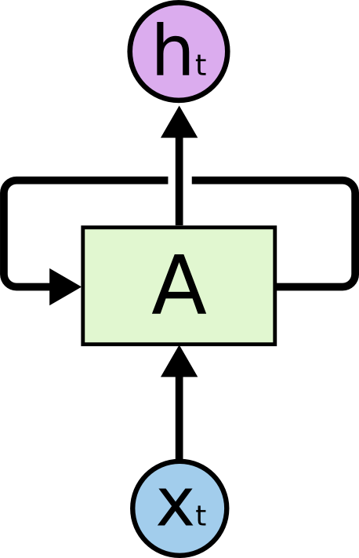
Sequence data
We don’t understand one word only
We understand based on the previous words + this word. (time series)
NN/CNN cannot do this
http://colah.github.io/posts/2015-08-Understanding-LSTMs/
Notes:
시퀀스 데이터가 많음
이전 데이터가 그 다음에 영향을 미쳐야됨

Slide 3

http://colah.github.io/posts/2015-08-Understanding-LSTMs/
Notes:
풀어 해지면 이런 형태

Slide 4
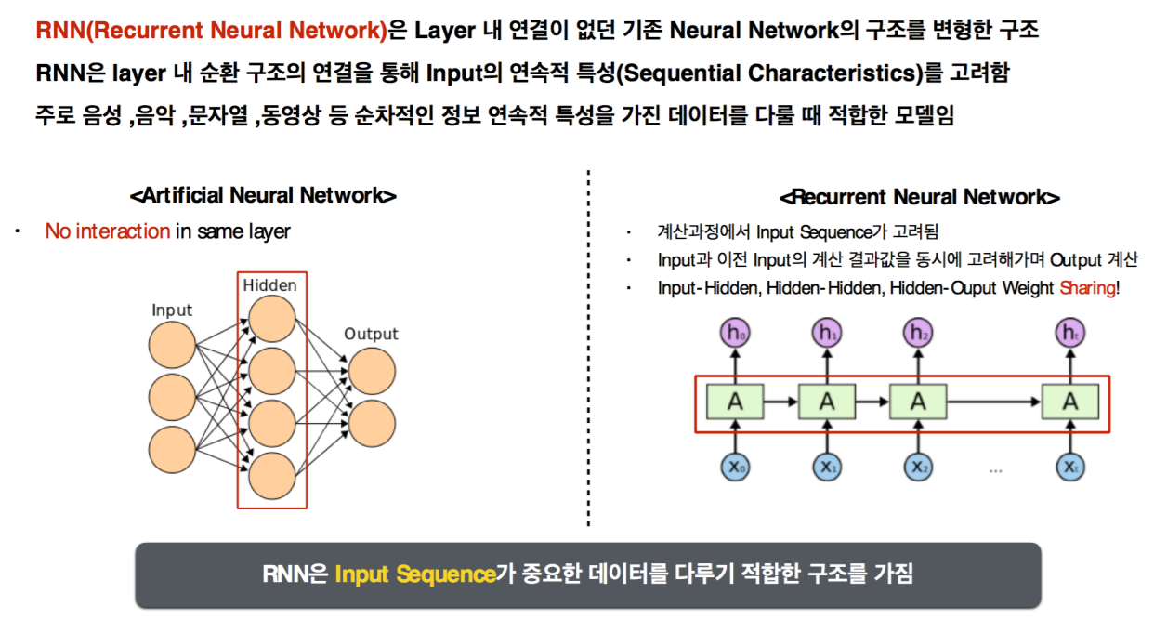
Notes:
NN의 꽃 이자 가장 재미있는 구조.

Slide 5
Recurrent Neural Network
y
usually want to
predict a vector at some time steps
RNN
x
Lecture 10 -
Fei-Fei Li & Andrej Karpathy & Justin Johnson Lecture 10 - 8 Feb 2016

Slide 6
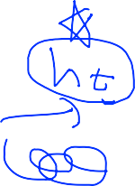

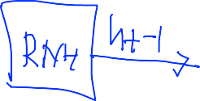
Recurrent Neural Network
We can process a sequence of vectors x by applying a recurrence formula at every time step:
y
RNN
new state
old state input vector at
some time step
x
some function
with parameters W
Lecture 10 -
Fei-Fei Li & Andrej Karpathy & Justin Johnson Lecture 10 - 8 Feb 2016
Notes:
State를 계산하고 state를 통해서 y를 계산
이전의 state를 사용함

Slide 7
Recurrent Neural Network
We can process a sequence of vectors x by applying a recurrence formula at every time step:
y
RNN
x
Notice: the same function and the same set of parameters are used at every time step.
Lecture 10 -
Fei-Fei Li & Andrej Karpathy & Justin Johnson Lecture 10 - 8 Feb 2016
Notes:
사용하는 Function이 동일

Slide 8

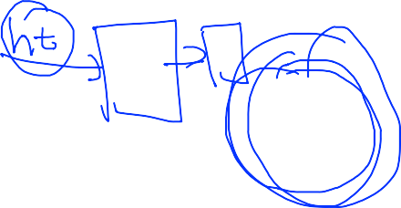
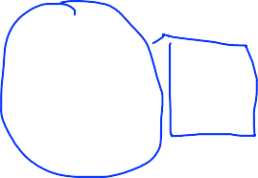



(Vanilla) Recurrent Neural Network
The state consists of a single “hidden” vector h:
y
RNN
x
Lecture 10 -
Fei-Fei Li & Andrej Karpathy & Justin Johnson Lecture 10 - 8 Feb 2016
Notes:
가장 기본이 되는 RNN
WX 형태로 h, x에 각각 곱해서 더해줌
각각 Weight를 사용, tanh을 이용해서 현재의 state를 계산
Y(출력)을 구할 때 구한 state에 Weight를 곱해서 구해줌
W의 형태에 따라 Y의 형태가 달라짐

Slide 9

http://colah.github.io/posts/2015-08-Understanding-LSTMs/
Notes:
하나의 노드에 3개의 W가 있음, 다른 노드들도 다 똑같은 W를 사용함

Slide 10
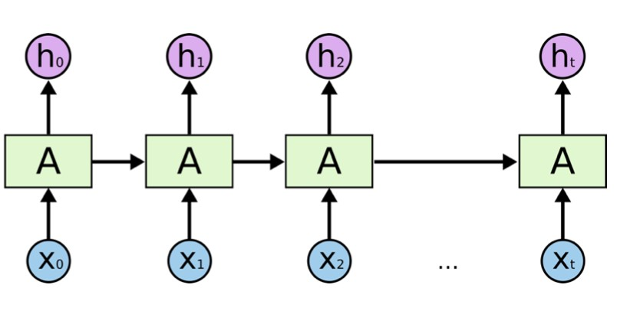


Character-level language model example
Vocabulary: [h,e,l,o]
Example training sequence:
“hello”
y
RNN
x
Lecture 10 -
Fei-Fei Li & Andrej Karpathy & Justin Johnson Lecture 10 - 8 Feb 2016
Notes:
네이버 검색어 자동완성 기능

Slide 11
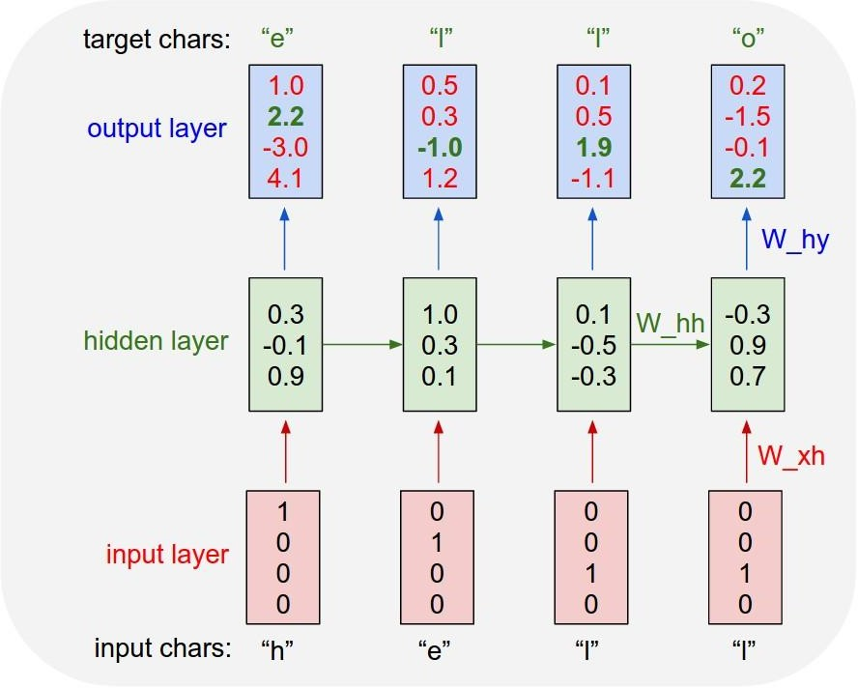
Character-level language model example
Vocabulary: [h,e,l,o]
Example training sequence: “hello”
Lecture 10 -
Fei-Fei Li & Andrej Karpathy & Justin Johnson Lecture 10 - 8 Feb 2016
Notes:
문자를 벡터로 표현해야됨 – one-hot encoding

Slide 12
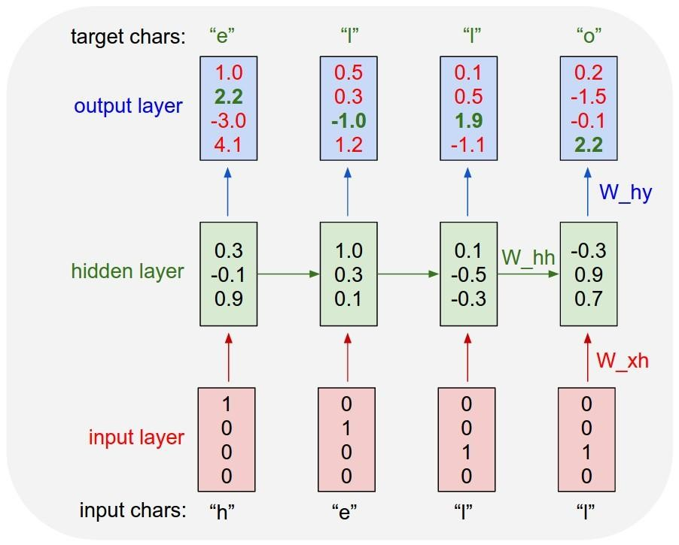

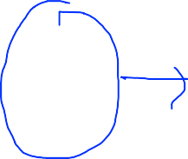



Character-level language model example
Vocabulary: [h,e,l,o]
Example training sequence: “hello”
Lecture 10 -
20
Fei-Fei Li & Andrej Karpathy & Justin Johnson Lecture 10 - 8 Feb 2016
Notes:
첫 번째는 h(t-1)을 0으로 두고 함

Slide 13

Character-level language model example
Vocabulary: [h,e,l,o]
Example training sequence: “hello”
Lecture 10 -
20
Fei-Fei Li & Andrej Karpathy & Justin Johnson Lecture 10 - 8 Feb 2016

Slide 14
Character-level language model example
Vocabulary: [h,e,l,o]
Example training sequence: “hello”
Lecture 10 -
20
Fei-Fei Li & Andrej Karpathy & Justin Johnson Lecture 10 - 8 Feb 2016

Slide 15
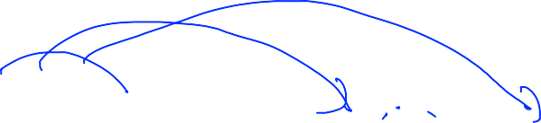
Character-level language model example
Vocabulary: [h,e,l,o]
Example training sequence: “hello”
Lecture 10 -
20
Fei-Fei Li & Andrej Karpathy & Justin Johnson Lecture 10 - 8 Feb 2016
Notes:
이전 값이 영향을 미치기 때문에 이전 값을 기억한다고 볼수 있음

Slide 16



정답
오답
Character-level language model example
Vocabulary: [h,e,l,o]
Example training sequence: “hello”
Lecture 10 -
21
Fei-Fei Li & Andrej Karpathy & Justin Johnson Lecture 10 - 8 Feb 2016
Notes:
마지막에 softmax를 취하게 되면 label을 할 수 있음
오답 = error 를 계산 / softmax의 cost 함수를 사용, 4개의 cost를 더해서 사용해서 학습을 시켜줌

Slide 17
RNN applications
https://github.com/TensorFlowKR/awesome_tensorflow_implementations
Language Modeling
Speech Recognition
Machine Translation
Conversation Modeling/Question Answering
Image/Video Captioning
Image/Music/Dance Generation
http://jiwonkim.org/awesome-rnn/
Notes:
시퀀스 데이터를 처리 할 때 많이 사용

Slide 18
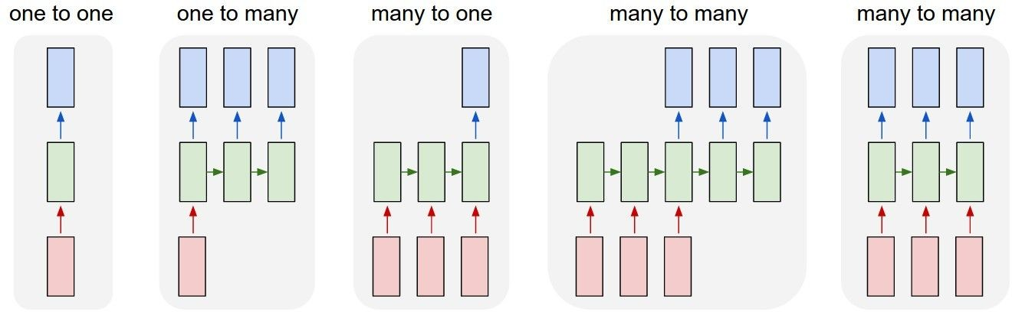
Recurrent Networks offer a lot of flexibility:
Vanilla Neural Networks
Lecture 10 -
6
Fei-Fei Li & Andrej Karpathy & Justin Johnson Lecture 10 - 8 Feb 2016

Slide 19
Recurrent Networks offer a lot of flexibility:
e.g. Image Captioning
image -> sequence of words
Lecture 10 -
7
Fei-Fei Li & Andrej Karpathy & Justin Johnson Lecture 10 - 8 Feb 2016

Slide 20
Recurrent Networks offer a lot of flexibility:
e.g. Sentiment Classification
sequence of words -> sentiment
Lecture 10 -
8
Fei-Fei Li & Andrej Karpathy & Justin Johnson Lecture 10 - 8 Feb 2016

Slide 21
Recurrent Networks offer a lot of flexibility:
e.g. Machine Translation
seq of words -> seq of words
Lecture 10 -
9
Fei-Fei Li & Andrej Karpathy & Justin Johnson Lecture 10 - 8 Feb 2016

Slide 22
Recurrent Networks offer a lot of flexibility:
e.g. Video classification on frame level
Lecture 10 -
10
Fei-Fei Li & Andrej Karpathy & Justin Johnson Lecture 10 - 8 Feb 2016

Slide 23
Multi-Layer RNN
Notes:
여러 개의 레이어를 둘 수도있음

Slide 24
Training RNNs is challenging
Several advanced models
- Long Short Term Memory (LSTM)
- GRU by Cho et al. 2014
Notes:
보통 LSTM, GRU를 사용

Slide 25
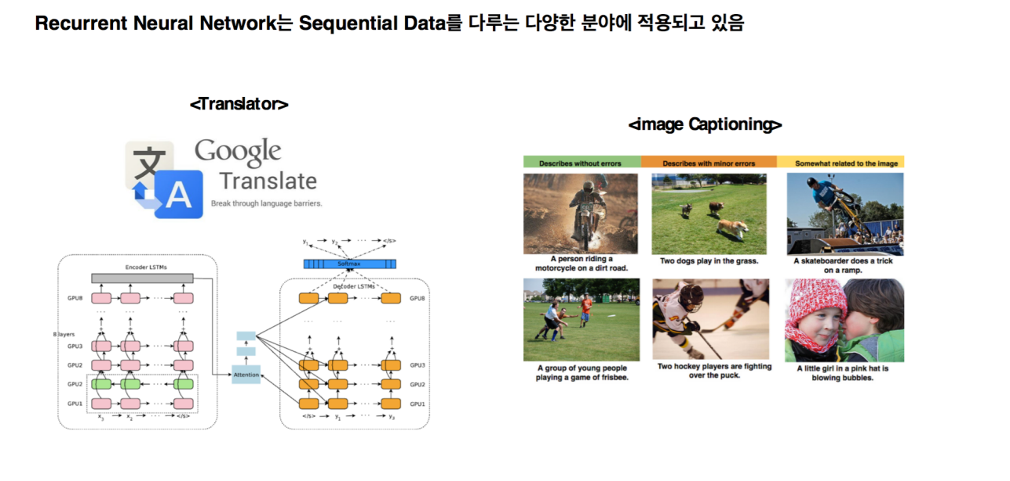
Notes:
NN의 꽃 이자 가장 재미있는 구조.

Slide 26
Notes:
NN의 꽃 이자 가장 재미있는 구조.

